Slide 1

CoPilot Safe Assist
Software Engineering 2: Project Teamwork Mälardalen University
Optimus Octavian

Slide 3
High Level Architecture
Tiered-Client-Server Structure
Server-Client with Model View Controller in the client
MVC with a connection to server
Notes:
- Few are those who like design decisions in front of their implementation, but well, you have to do it.... We have been shuffling several architectures as you can see

Slide 4

High-Level Architecture
Tiered-Client-Server Structure
Server-Client with Model View Controller in the client
MVC with a connection to server
Notes:
-In the tier client/server, most or all of the application logic and data is hosted on a server but we decide we needed an independent view to show the different data

Slide 5
High-Level Architecture
Tiered-Client-Server Structure
Server-Client with Model View Controller in the client
MVC with a connection to server
Notes:
-It seemed to us that it was overlooked having a MVC inside the client

Slide 6
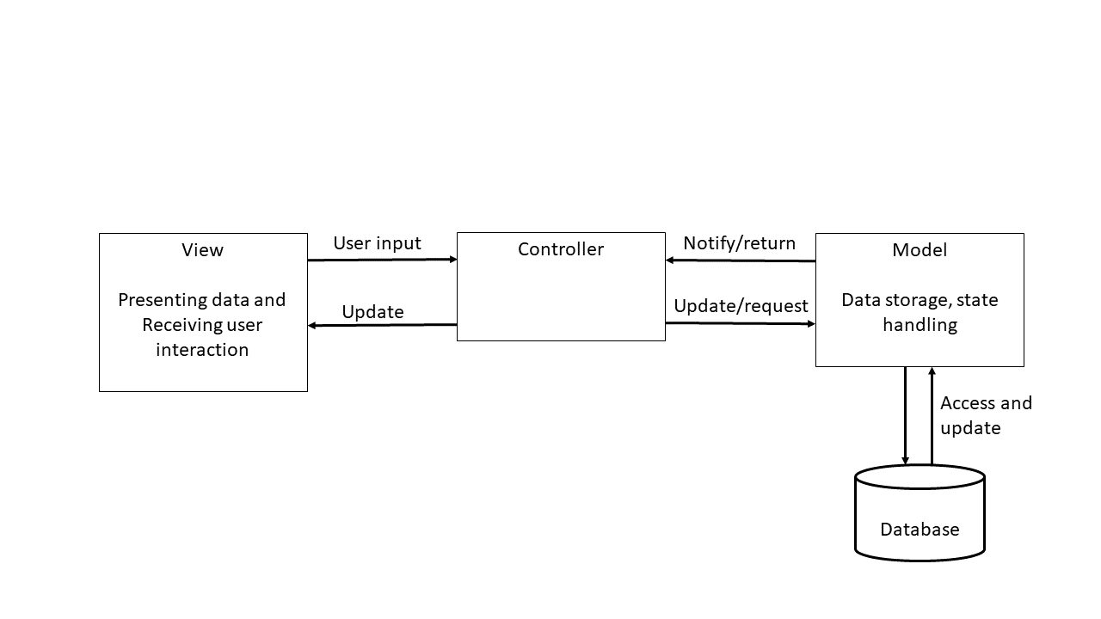
And the winner is…
-MVC with a connection to server
Notes:
-In order to centralize the operations in the server but keeping a client active, we proposed an MVC with a connection to server:
-View: User Interface
-Controller: Will process all the info provide by the client
-Model: Will store the current status and the data resulted in the operations

Slide 7
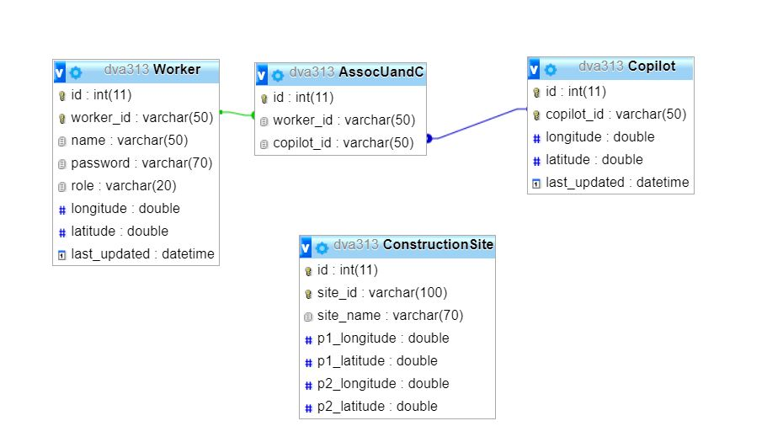
Being the DB like…
Notes:
-Here we can see the structure of the DataBase that will store some important information like:
-The association between the Worker and the Co-Pilot (that Will be an Operator Machine?)
-The Construction Site info where all will happens

Slide 8
What motivated the design?
The DB not be able to store data of the workers
Co-Pilot has API 15
The workers and operator must provide location
Notes:
- ”The DB not be able to store data of the workers”: We talk about personal data that could be stolen
“Co-Pilot has API 15”: Android 4.0.3 (Ice Cream Sandwich)
“The workers and operator must provide location”: To be able to calculate the location of the Units every moment (but only inside the construction site (safety feature))

Slide 9
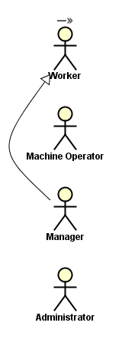
¿Who are the actors?
Will work in the Construction Site
Will work in a machine (with Co-Pilot)
Will manage all about the Construction Site (Inside the Construction Site)
Will manage the workers
(Outside the Construction Site)

Slide 10
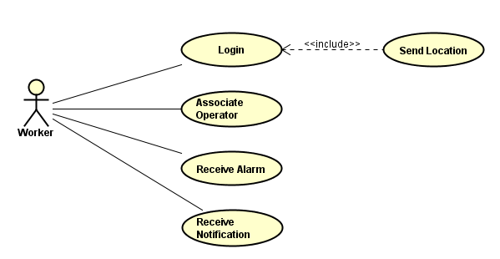
Worker
Notes:
If you log in, you send your location to the server automatically
Associate operator (to a machine)
Receive alarm (in a dangerous situation)
Receive notification (for notice the worker of things like: “Be careful!! You are in a Construction Site”)

Slide 11
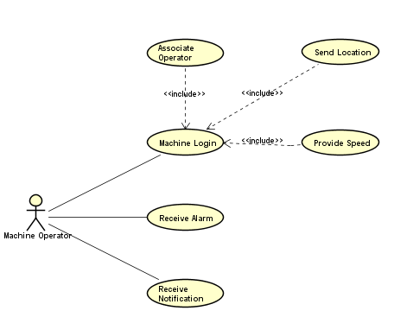
Operator Machine
Notes:
- If a machine operator logs in, it must be associated its handleDevice to the Co-Pilot and also, like the worker, it will send its location to the server automatically but, also its speed since speed is important in calculations
Receive alarm (in a dangerous situation)
Receive notification (for notice the worker of things like: “Be careful!! You are in a Construction Site”)

Slide 12
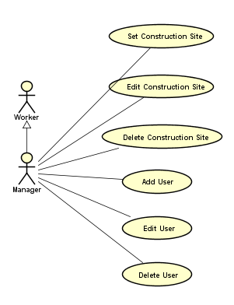
Manager
Notes:
Set, Edit and Delete the Construction Site where all will happens…
Add, Edit, Delete user: For temporally situations as a worker cannot work today because is sick or somthing like that, to do this in a long period there is…

Slide 13
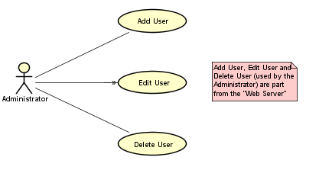
Administrator
Notes:
… that will do the same but not in the application as you will see after (NO SPOILERS). It will add, edit and delete users for a long period.
-This part belongs to the “Web Server” Side

Slide 14
Who is doing what?
-Handheld Device: Provide Location and listening to notifications and alarms
(Co-Pilot included)
-Server: Calculate locations and send notifications and alarms to handheld devices
Notes:
Handheld Device: That is the pone of the workers and the Co-Pilot integrated in the machines
Server:

Slide 15
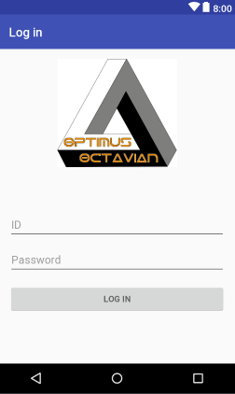
GUI

Slide 16
GUI
Notes:
Hablar de la decisión de colores y de fases de peligro

Slide 17
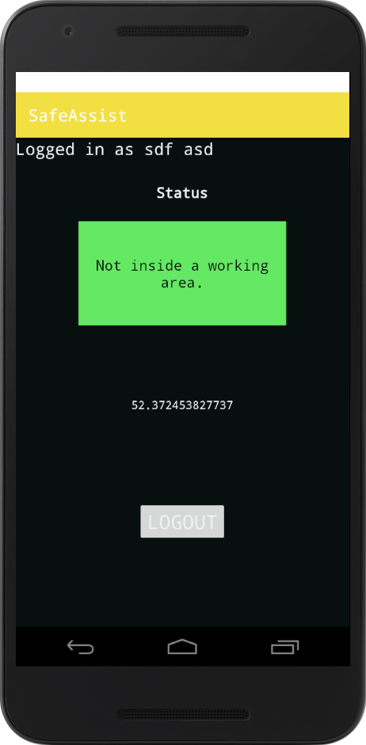
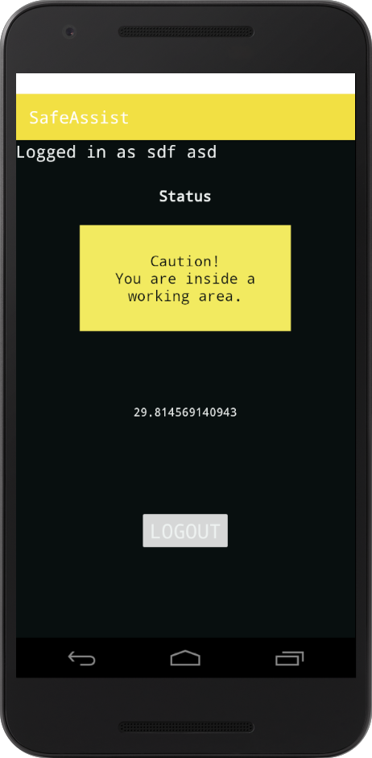
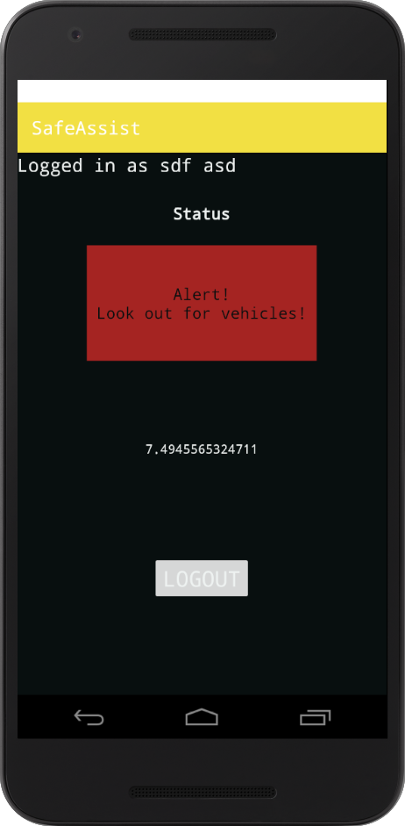
DEMO SCREENSHOTS

